Slide 1




Perceptions of positive effects of Malvazija istarska moderate wine consumption on human health and psychological functioning - A preliminary study
Anita Silvana Ilak Peršurić, Sara Rossi, Ena Bestulić, Sanja Radeka
Institute of Agriculture and Tourism, K. Hugues 8, 52440 Poreč, Croatia
Corresponding author: Tel.:+385052408329; E-mail address: anita@iptpo.hr
EuAWE Conference, UTAD, Villa real, Portugal, 18-21. May 2022.

Slide 2

1. Introduction
The purpose of the study presented was to show the perception of wine, motivations for consumption and effects on psysical and psychological well-being.
The main objective of the survey was to provide evidence about moderate wine consumption of Malvazija istarska on human health, the possible positive effects of wine consumption on psychological well-being and to detect positive perceptions towards wine.

Slide 3
2. Methodology
Data collection was performed with a sample of 184 Croatian wine consumers during 2019 and 2020.
Data were colected on the Croatian Science Foundation scientific project “Vinum Sanum” “Influence of different vinification technologies on qualitative properties of wines from autochthonous Croatian varieties: the role of wine in human diet”.
The wine consumed was produced of the Croatian autochthonous white grapevine variety Malvazija istarska
Participants consumed wine in a moderate way 2 dl wine daily during a six week trial.

Slide 4
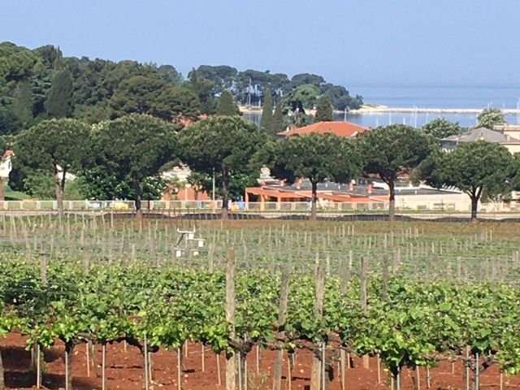
Vineyards of Malvazija istarska at the Institute Poreč

Slide 5
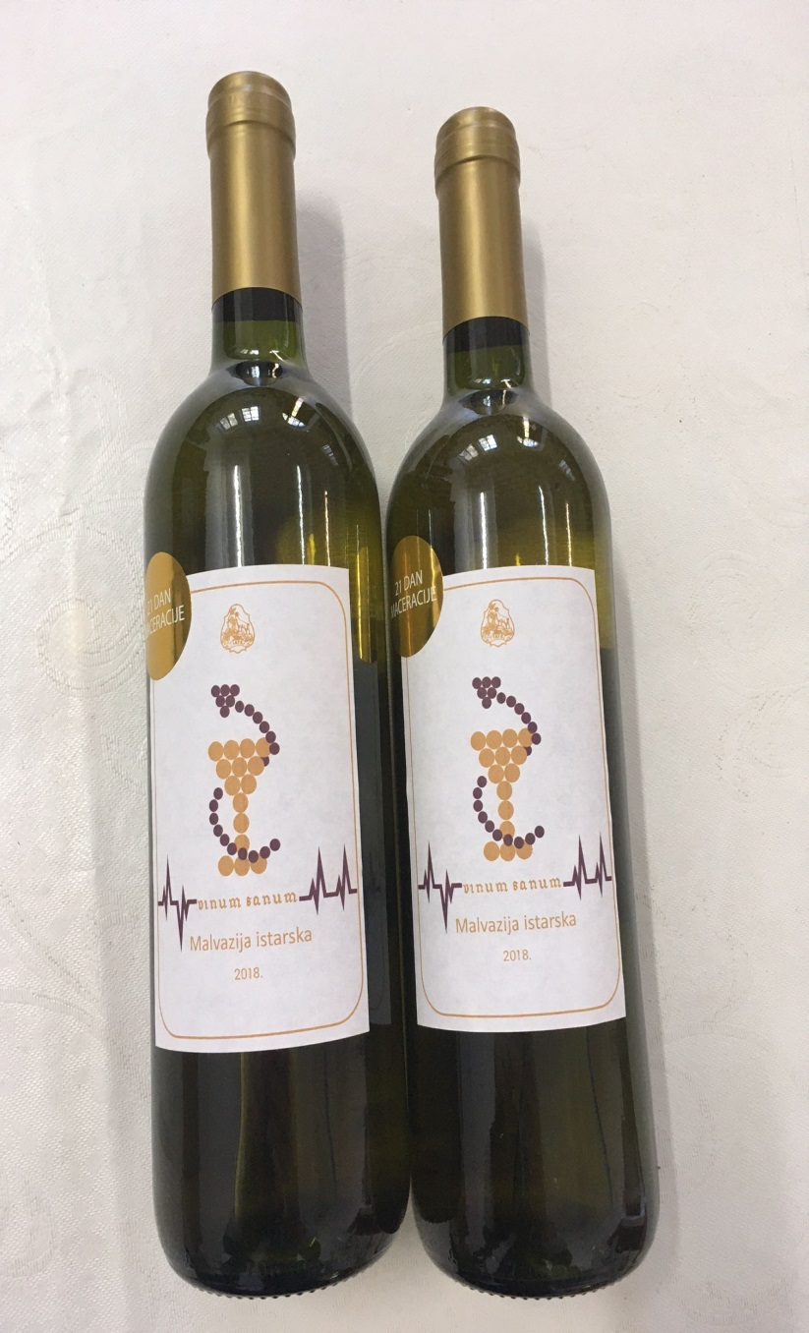
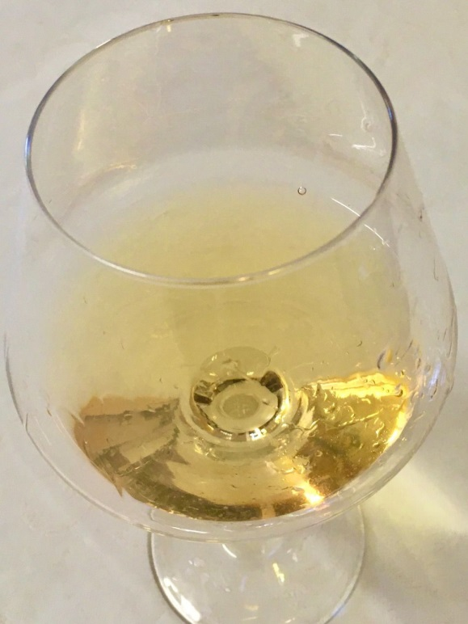

Slide 6
The survey with the questionnaire was performed at the Institute of agriculture and tourism in Poreč and at the Faculty of Humanities and Social Sciences in Rijeka.
The questionnaire was administered to adult wine consumers (over age 18) and the informed consent was obtained from all participants involved in the study.
The study was carried out in accordance with the Declaration of Helsinki developed by the World Medical Association and was approved by the Ethics Committee of the Clinical Hospital Center Rijeka (Croatia).

Slide 7
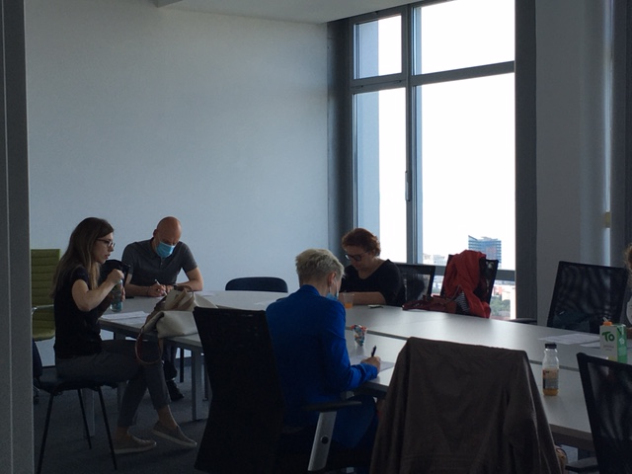
Participants filling out Questionnaires

Slide 8

3. Survey results
The sample consisted of the respondents in majority female (59.3%), and in minority males (40.7%).
Most respondents had between 26 and 56 years of age (56%).
According to their employment status the majority were employees (60%), and the minority were entrepreneurs/self-employed, managers, unemployed/retired, students/pupils.
They have obtained in ¾ of cases higher education level, while ¼ of participants had secondary education.

Slide 9
Descriptive analysis of wine consumption patterns

Slide 13
Factor analysis of wine attribute and health effects

Slide 14

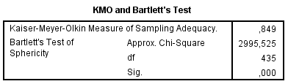

Slide 15
Psycological well-being
Factor Matrix
 | Factor
 | 1 | 2 | 3
General well-being |  |  | .457
Nervosis | -.234
Self-Control |  | .868
Sadness |  |  | .256
Under pressure | .445
Happy |  | .604
Loosing sense |  | .607
Anxious |  |  | -.670
Awake rest full and fresh |  |  | .516
Current diseases effects |  |  | -.490
Full life |  |  | .449
Depressed | .999
Emocionaly stabile |  |  | .679
Tired |  |  | .370

Slide 16
Goodness-of-fit Test
Chi-Square | df | Sig.
143,645 | 52 | ,000

Slide 17


Conclusions
Wine consumption preferences showed patterns of moderate wine consumption habits:
Preference for dry wines, preference for young fresh wine types
Perception of wine showed:
relaxation effects
hedonism effects
health effects
apreciation of wine quality and healthiness
Psycholgical well-being related to positive feeling of hapiness, emocional stability and positive general well-being feeling.

Slide 18

THANK You four your time & attention authors

